Slide 1


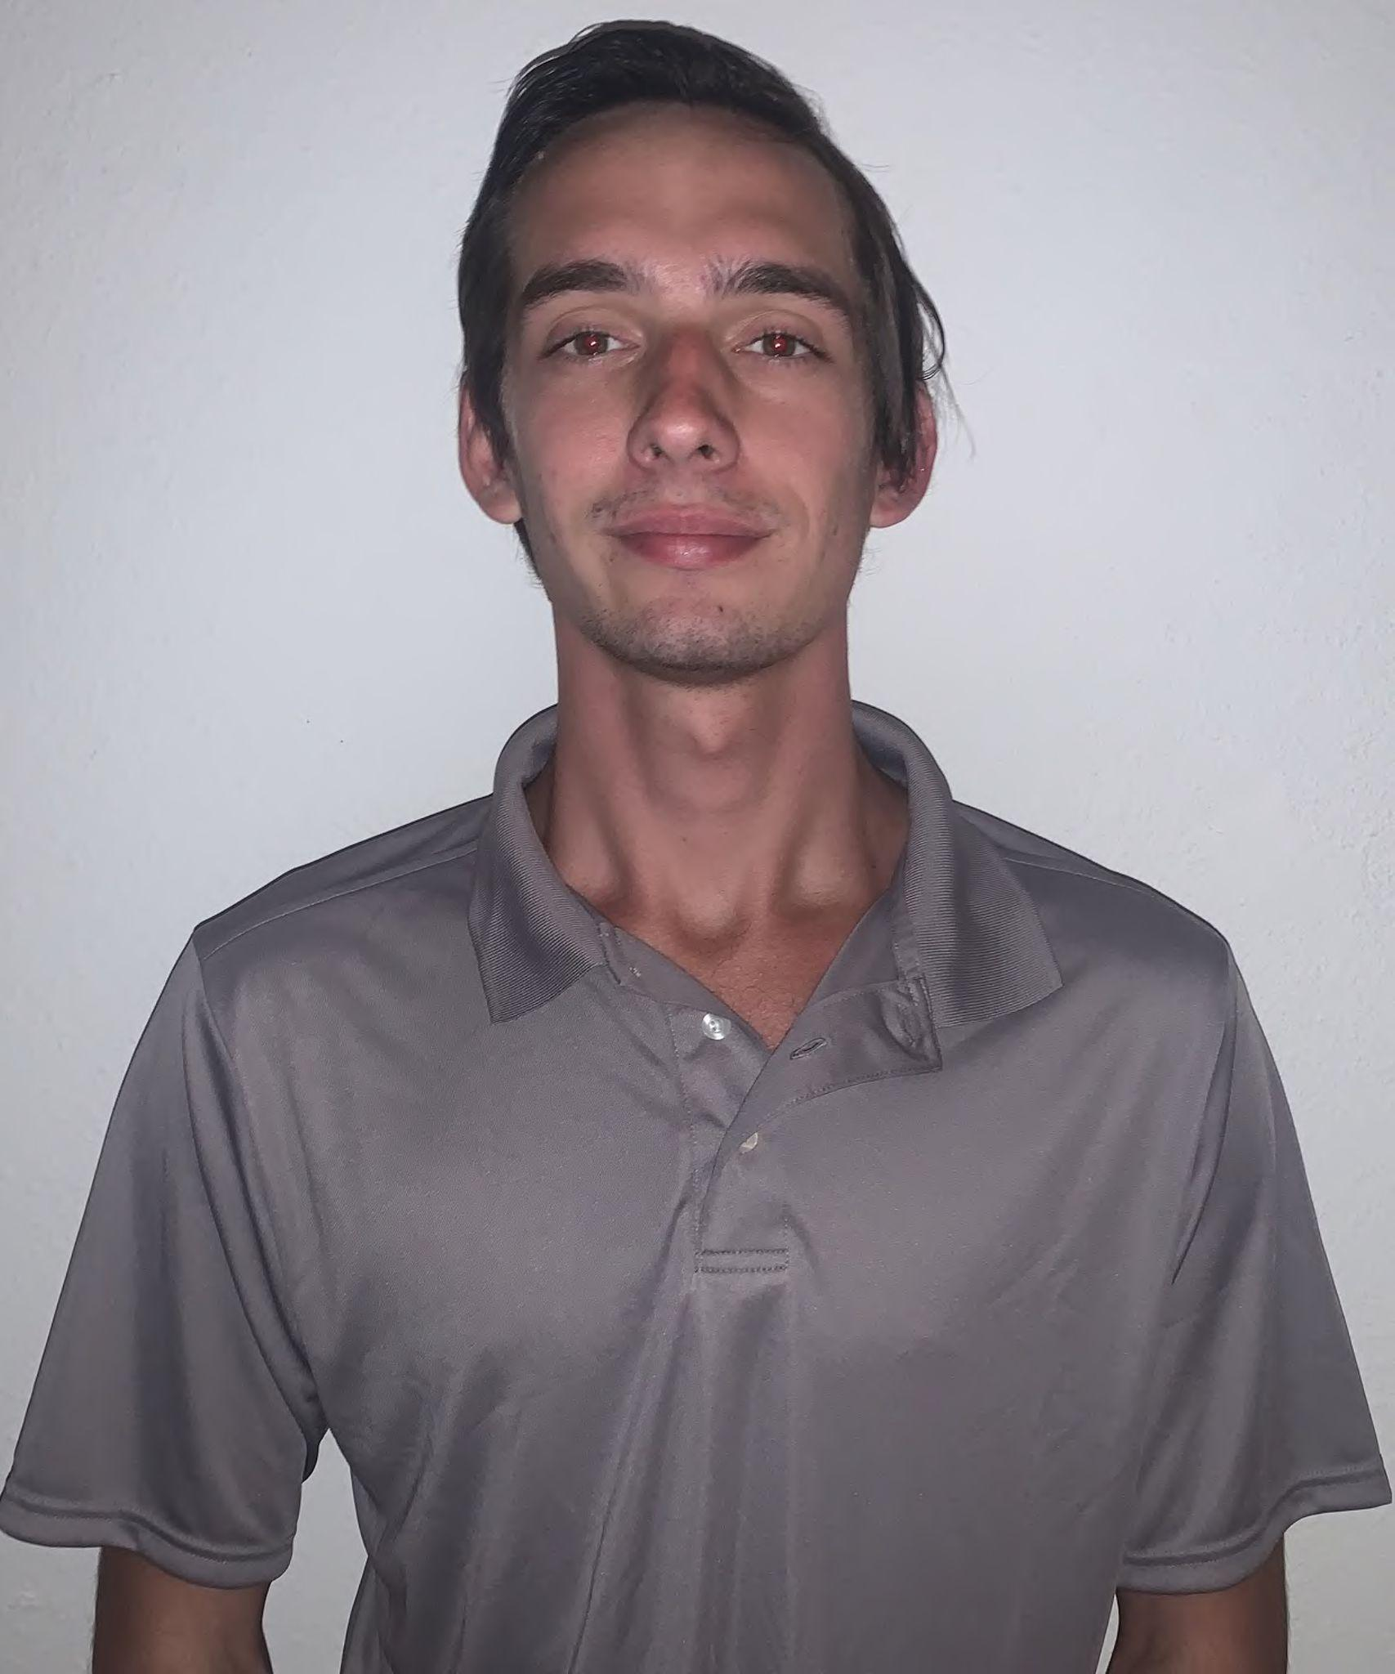
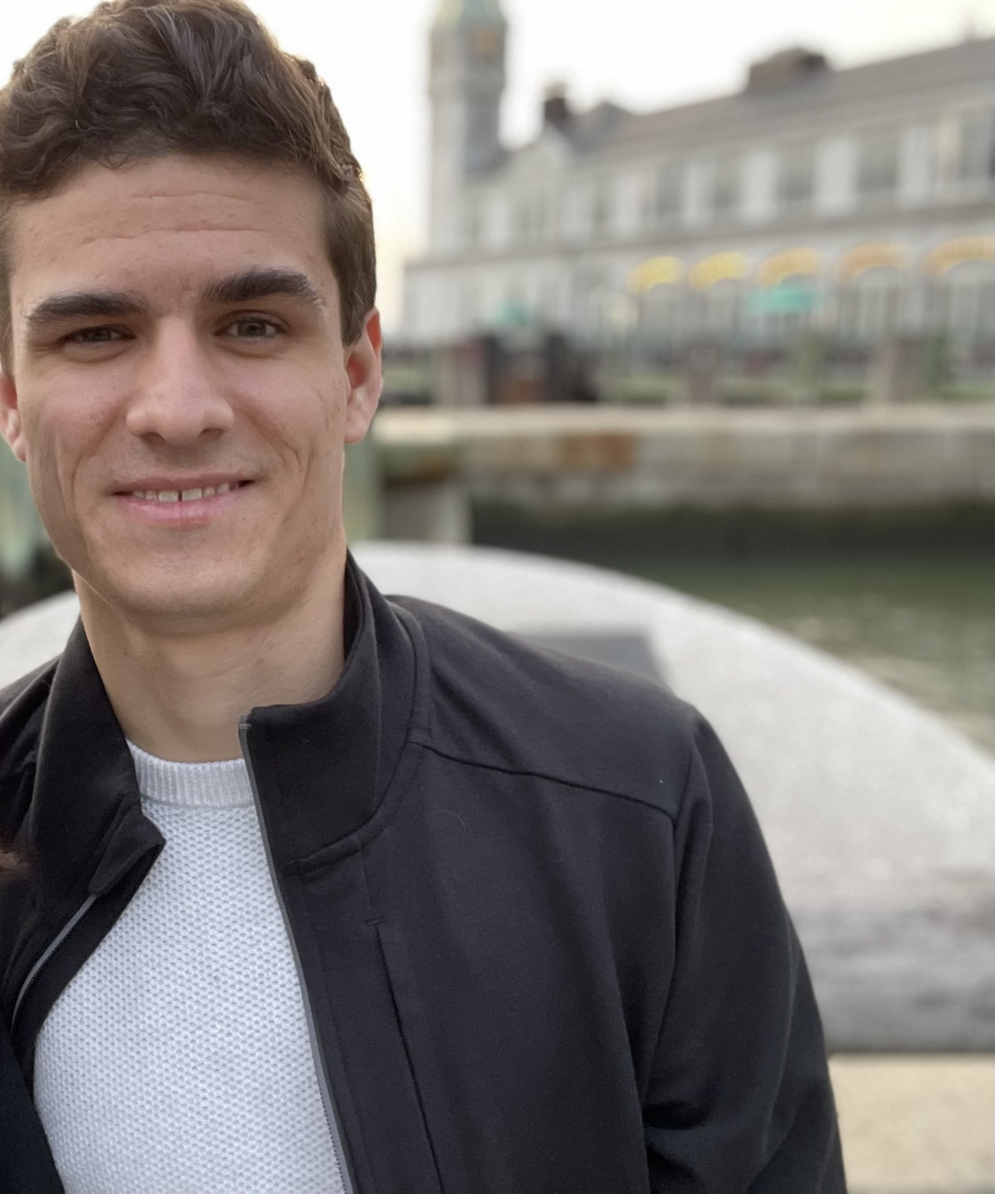

Aether Sensor Network
Critical Design Review
Ian Wallace
Computer Engineering
Parke Benjamin
Electrical Engineering
Paul Wood
Computer Engineering
Randy Alvarez
Electrical Engineering
Notes:
Paul

Slide 2
Project Motivation
Provide a device that will assist those sensitive to negative changes in outdoor and indoor air quality
People with respiratory conditions
Wildfires
Cities
Industrial areas
Provide a solution that is cheaper than existing alternatives
Create a device that estimates both outdoor and indoor air quality
Notes:
Paul

Slide 3
Project Goals
Design a device that can detect air pollutants in the surrounding area
Estimate the EPA’s air quality index (AQI)
Measure indoor VOCs and estimate the indoor air quality (IAQ)
Wirelessly send the data using a long distance, low power communication protocol
Operate off of both solar power and battery
Collected data will be displayed on a website
Notes:
Ian

Slide 4
Project Objective
Low cost and lightweight
Require little to no maintenance
Easy to install
Communicate sensor data over a LoRaWAN network
Display collected sensor data on a web application
Notes:
Ian

Slide 5
Project Requirements
Will be able to dynamically power the device from either the battery, solar panel, or USB
Interact with the device over a serial USB interface in order to perform configuration and read device data, such as sensor data
Display sensor data on the website using a map overlay of the local area
The device itself costs less than $250
The device weighs less than 5 lbs
The volume of the device will be less than 6 x 6 x 6 inches

Slide 6
Project Constraints
Time was a major constraint (only ~6 months)
Money was a constraint
Managing complexity

Slide 7
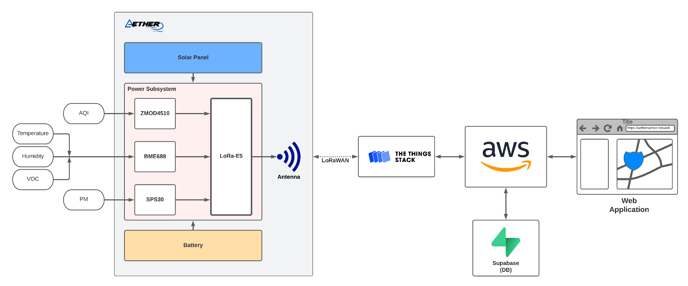
Overall Design
Notes:
Paul

Slide 8
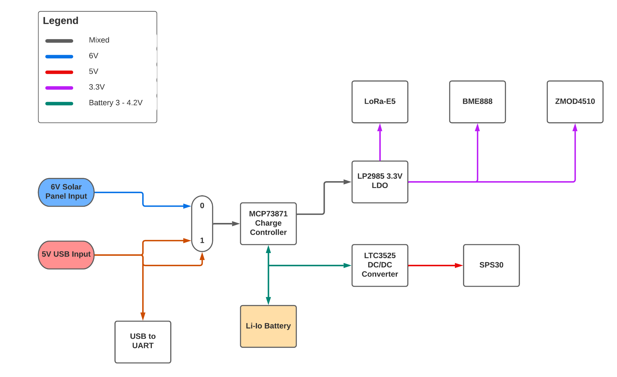
Power Subsystem Block Diagram
Notes:
Parke-Here we can see a basic diagram describing what the power circuit should look like. In design we required 2 things. A unit must be able to power itself and a unit must be able to be charged by the user. We can accomplish that with 3 power sources.
First a solar panel as when a device must be stationary and power itself its realistically the only option. Second we must find a way for the unit to hold a charge when the solar panel is not providing sufficient power. To this end we must provide a battery to support power consumption during periods of low power and become charged during periods of high power. Lastly to power the unit on the user end we wanted to provide a readily available, highly functioning power source. We came to the conclusion that a 5V power source from USBC would provide the best charging capabilities. Next we needed a way to convert the solar panels power range as well as the USBC source to the same voltage regardless of input while also charging the battery. To this end we implemented the MCP73871 charge controller. This unit accomplishes all our wants while effectively using and charging a lithium ion battery. Finally we had to take the consistent output of the MCP and provide it to critical units. To accomplish this we will use two power rails that will convert voltages to their desired levels and provide it to the loads of our design.

Slide 9
Solar Power and USB Design
The Aether sensor node can charge the Li-Ion battery and power the system through either a 5.5W 6V solar panel DC input or a 5V USB-C input
Since the voltage collapse of a solar panel can be sudden a 4700uF capacitor helps stabilize the panel
A schottky diode charges the 4700uF capacitor from the panel and prevents the capacitor from draining back into the panel
The USB section of the power system incorporates ESD diode protection circuitry along with a USB-to-UART communication interface chip (CP210N)
This interface is needed since LoRa-E5 microcontroller cannot communicate directly via USB protocol

Slide 10
Battery and Charge Controller
A 3.7/4.2 lithium-ion battery will be the battery source for the Aether node
The heart of this power system design is the solar/USB charge controller MCP73871 responsible for providing load sharing features efficiently meeting system load demands
When the charger is powered with USB/Solar inputs the load sharing feature on the MCP73871 allows the load current to go directly from the input voltage to the output while simultaneously charging the battery
The battery is only used when the system load draw exceeds what the power input can provide thus extending battery life and efficiency
Three status pins on the MCP73871 indicate when the battery is being charged, when the battery is fully charged, and when the charger has power
To prevent the charger from overheating the battery or attempting to charge when the battery is too hot, the MCP73871 will have a 10k NTC thermistor to monitor battery temperature
The maximum charge current is set through programming (PROG) resistors and will be set to 500mA in this design

Slide 11
Power Rails
The design calls for several power sources with varying voltages, likewise our selected sensors also have different voltage requirements.
As a result our power system must be able to take in and distribute power to and from multiple areas on the board, providing the correct voltage to the respective components
To meet this requirement three chips have been selected.
The LP2985 is needed to convert the MCP73871 output to a 3.3V for the microcontroller and sensors
Finally the LTC3525 converts the Li-Ion battery voltage to 5V for our PM sensor. It also has a function to shutdown when not in use to lower power consumption for the system as a whole.

Slide 12
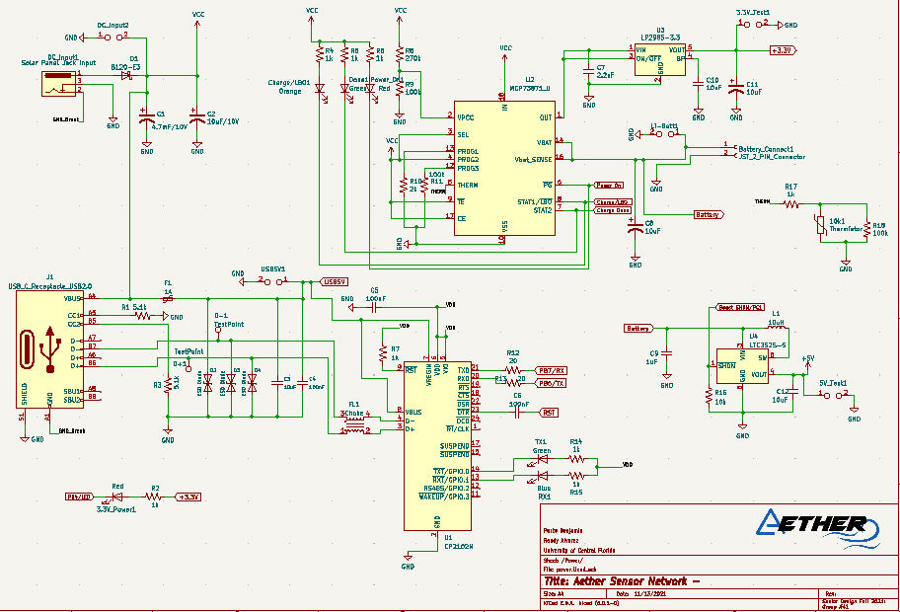
Power Subsystem Schematic

Slide 13
Power Usage
Part | Input V high(V) | Max Current(mA) | Max On Power usage(mW)
PM Sensor | 5.5 | 65 | 357
Renesas AQI Sensor | 3.6 | 13 | 46.8
Bosch Sensor | 3.6 | 15 | 54
Seed LoRa-E5 | 3.6 | 150 | 540
Other Losses | 3.3 | 1 | 3.3
The max power used would come out to 0.998W while the device was in use. However during sleep mode the device would use approximately 62uW. This leads us to calculate that with a 2Ah battery while taking measurements every hour our system could survive 2 months on a fully battery charge.

Slide 14
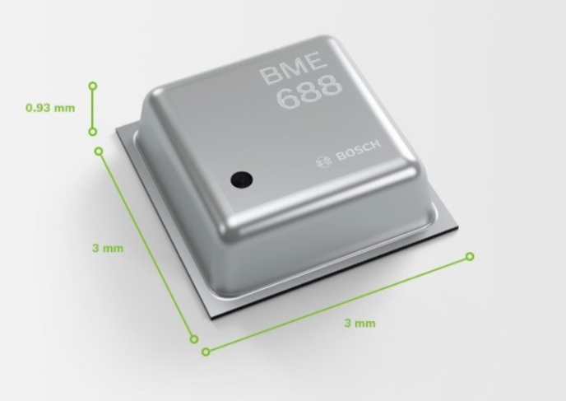
Bosch BME688 Sensor
A digital low power gas, pressure, temperature and humidity sensor with integrated Artificial Intelligence to train the sensor to recognize specific gases, smells and VOCs and VSCs
Applicable for indoor and outdoor air quality management
I2C communication protocol
Notes:
Randy

Slide 15
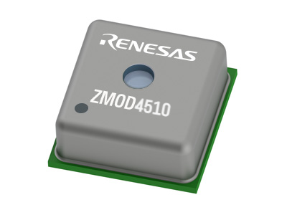
Renesas ZMOD Sensor
Gas Sensor Module for targeting NO2 & O3
Non-selective measurement of nitrogen dioxide (NO2) and ozone (O3)
Selective ozone (O3) measurement using ultra-low power
The module is a 12-pin LGA assembly (3.0 × 3.0 × 0.7 mm)
I2C communication protocol

Slide 16
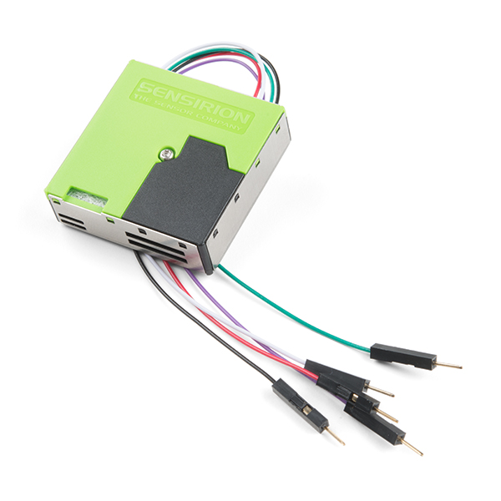
Sensirion SPS30 Particulate Matter Sensor
Particulate Matter Sensor for Air Quality Monitoring and Control
Measurement principle is based on laser scattering
Precision for different PM types and higher-resolution particle size for the detection of different sorts of environmental dust and other particles
Dimensions of 41 x 41 x 12 mm^3

Slide 17
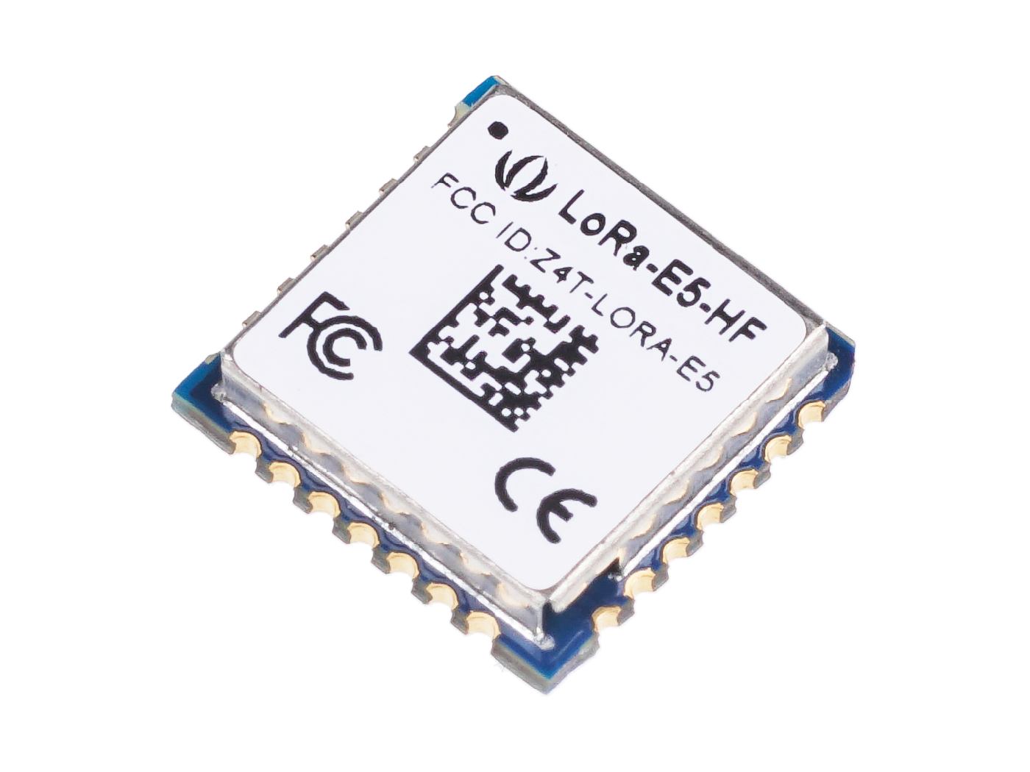
LoRa-E5 Microcontroller
Low-cost, ultra-low power, ultra-small size LoRaWAN module which utilizes ST system-level package chip STM32WLE5JC
Suited for wireless sensor networks and IOT applications
Small size: 12mm x 12mm x 2.5mm, 28 pins SMT
158dB link budget, suitable for long distance
Compatible with I2C interface

Slide 18
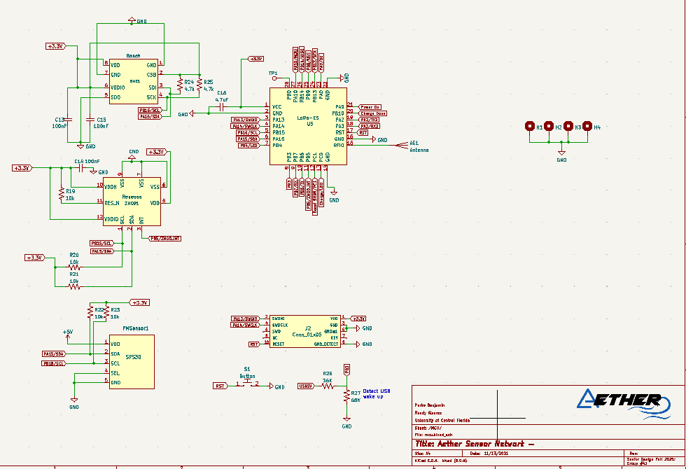
MCU and Sensor Subsystem Schematic
BME688 Sensor
LoRa-E5
Renesas ZMOD4510 Sensor
SPS30 Sensor

Slide 19
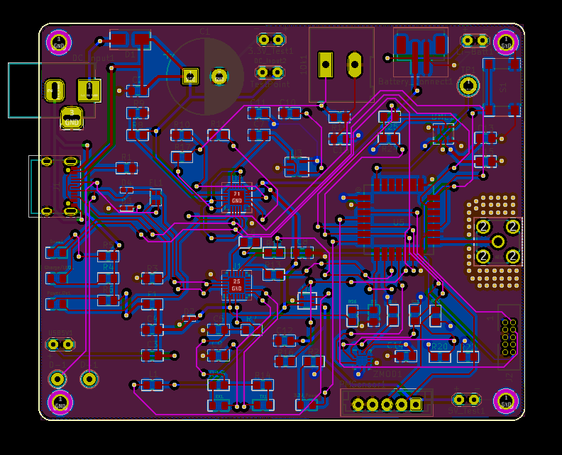
PCB Routing Layout
A 4 Layer PCB was used:
Top and Bottom Layer were used for signals
The 2nd layer was used as a 3.3V plane and to route other power signals
The 3rd layer was used as a ground plane
Board dimensions of 82.5mm x 68mm

Slide 20
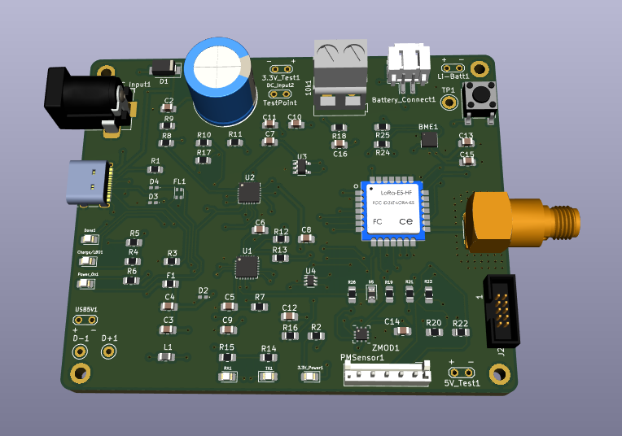
PCB 3D Model

Slide 21
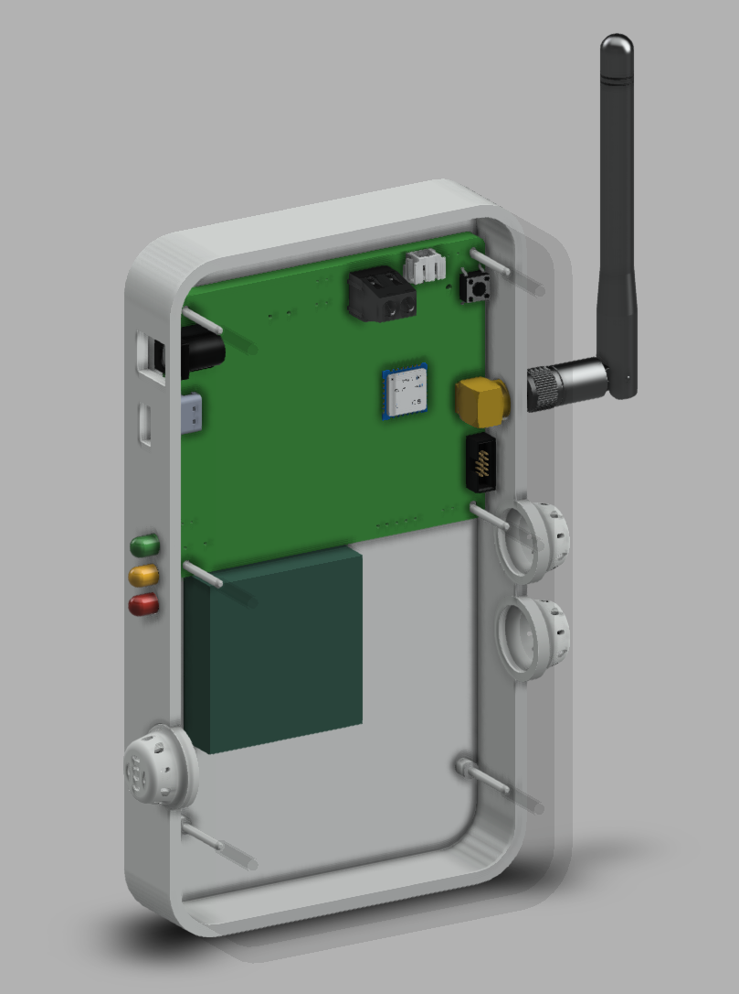
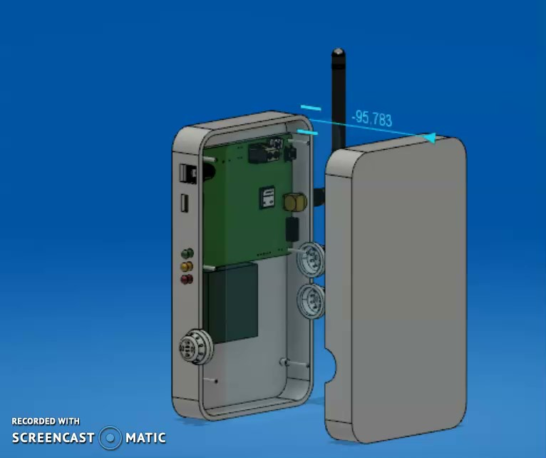
Enclosure 3D Model

Slide 22
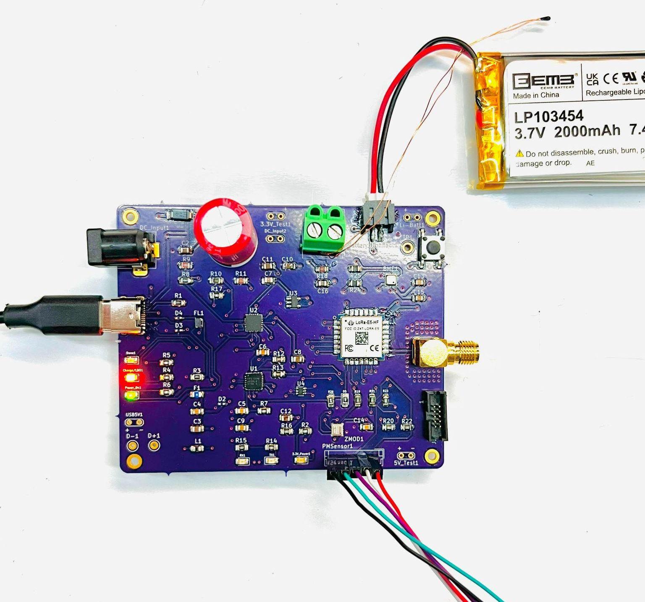
PCB Photo

Slide 23
Firmware Design Requirements
Read data from the BME688, ZMOD4510, and particulate matter sensor.
Send the recorded sensor data over LoRaWAN to AWS and our web application.
Manage the power systems on the board to put sensors in a low power or turn them off when not in use.
Allow the user to configure the device (such as setting LoRaWAN IDs) via a serial USB connection using a CLI or GUI.
Notes:
Ian

Slide 24
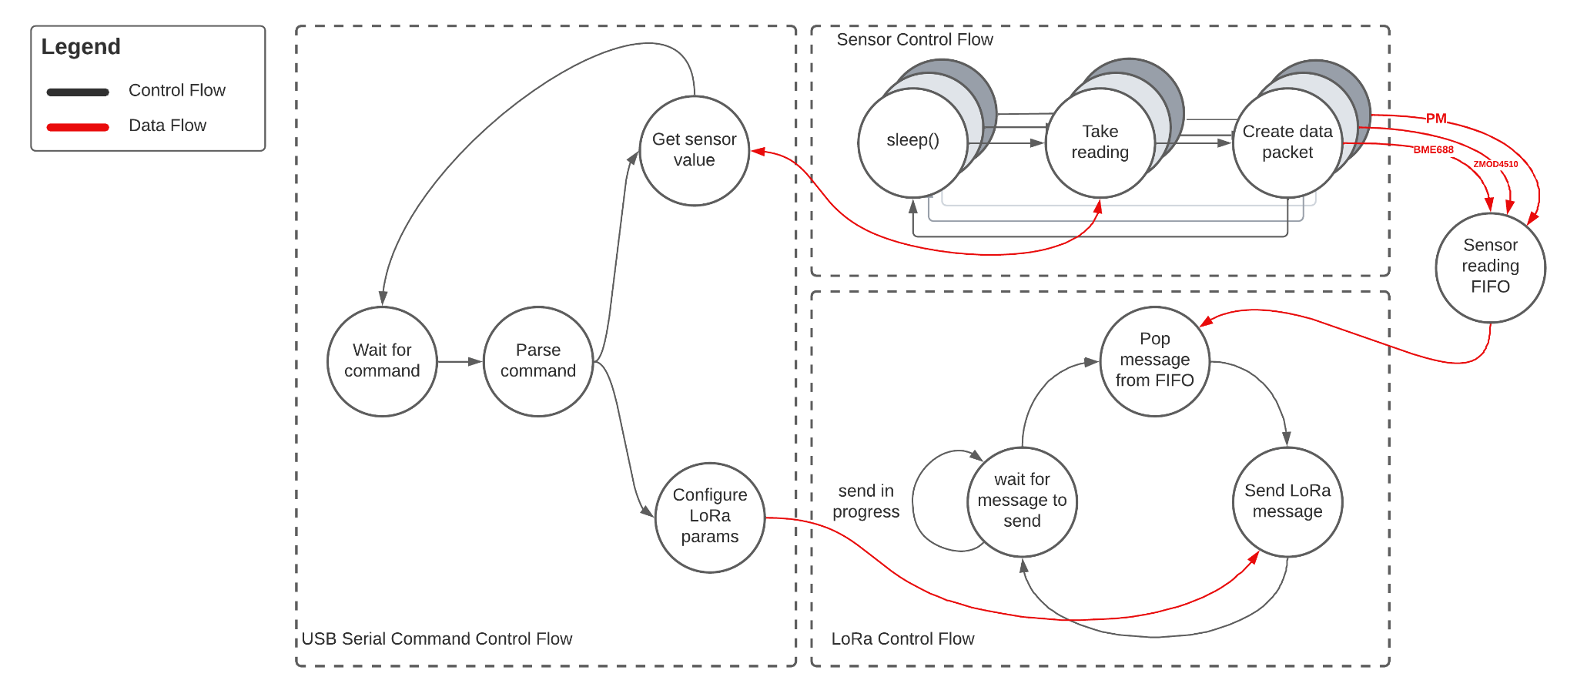
Firmware Block Diagram

Slide 25
FreeRTOS vs Zephyr RTOS
We had to select both a development environment and an RTOS
FreeRTOS + STM32CubeIDE
Native support by STM32CubeIDE, which is the dev environment provided by STM
More minimal, lower resource usage.
Potentially less work to set up device drivers due to less abstraction
Harder to work with the devices in the application code due to less abstraction
Zephyr RTOS
No IDE. Uses command line build tools.
More resource usage
Higher learning curve
Devices are abstracted away using DeviceTree, leads to more initial work to set up the device drivers.
Far easier to work with devices in the application code due to the internals being abstracted away.
We decided to go with Zephyr RTOS

Slide 26
Firmware Design
The use of Zephyr RTOS provides a straightforward way to organize our application into various task-specific threads:
Each sensor will have it’s own dedicated thread to manage the timing of sampling as well as taking samples.
A thread will be assigned to handle sending/receiving LoRaWAN messages.
A thread will be listening for when the USB cable is plugged in, in order to handle serial commands.
Power management will also be handle through the use of Zephyr’s power management API.

Slide 27
Firmware Design
Zephyr provides various tools for dealing with inter-thread communication.
We are using a FIFO to send data from the sensor threads to the LoRaWAN thread.
These inter-thread messages are formatted using a modified version of the CayenneLPP format.
This will be the same format the messages will be sent over LoRaWAN with
We will also likely use a FIFO for sending user commands from the USB command thread to get/set information in other threads.

Slide 28
Software Development Tools
Development is done in a text editor and command line environment, using Zephyrs command line build tools (west)
Building the application is easy using west build -b lora_e5_dev_board /path/to/our/app
To program the board, we use west flash
Version control is performed using Git with the repos hosted by GitHub
We are using GitHub organizations to centralize all the software developed and used by the Aether Team
Our GitHub organization also contains repos such as the code for our backend software, our KiCad project, and forked repos.

Slide 29
Web Application Requirements
Display data on a map overlay
Heatmap
Select between different sensor data types (AQI, VOC, etc) within a geographical area
Anyone can view the sensor data
Only owners of devices can view device specific information
Stretch goal: dashboard to manage devices, gateways, alarms, and view logs
Otherwise, manual database entry
Get SMS or email alerts
Notes:
Paul
Basics:
Display sensor data
Select sensor data to display
Interactive map
Click to get tooltip about device, specific readings
Easily request different data from the API as the progress evolves

Slide 30
Backend Requirements
Easy integration with LoRaWAN and IoT devices
Quick iteration and local testing, where possible
Repeatable deployments
Handle authentication
Handle relational IoT data
Cost effective
But not at the expense of creating too much complexity or time sinks
Notes:
Easy integration
Don’t worry about LNS
Don’t worry about device provisioning
Easy way to ingest data
IoT data
Has a lot of associated attributes, metadata

Slide 31
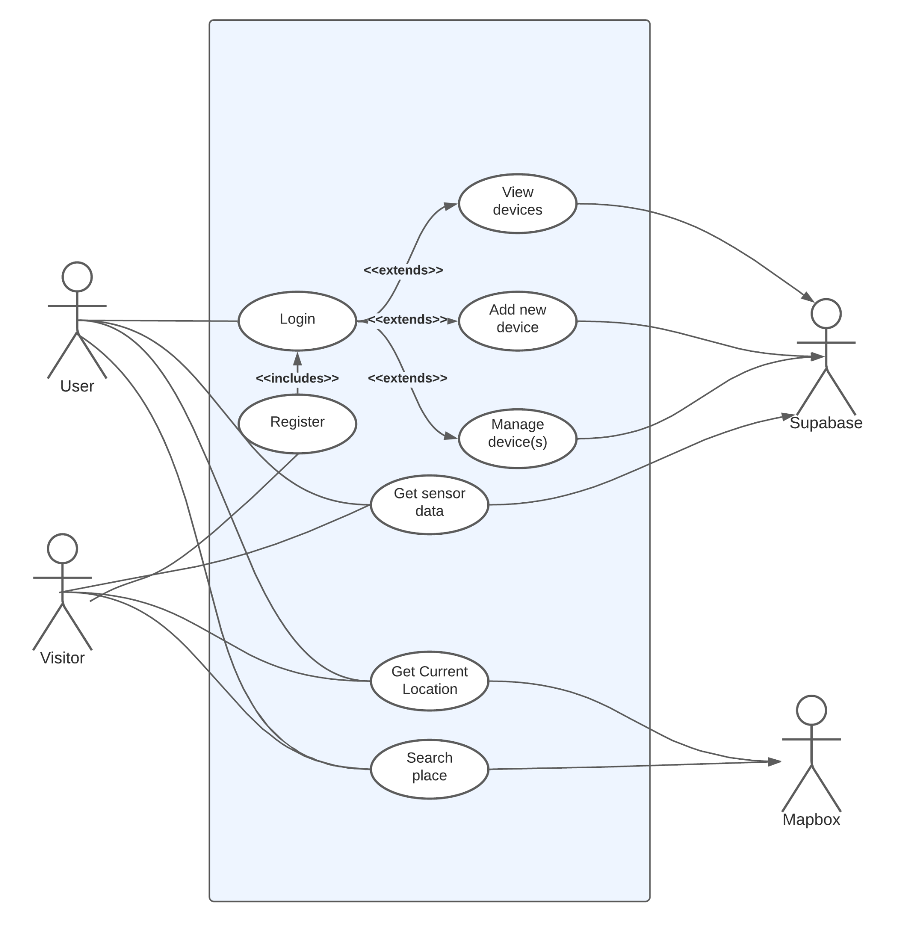
Use Case Diagram

Slide 32
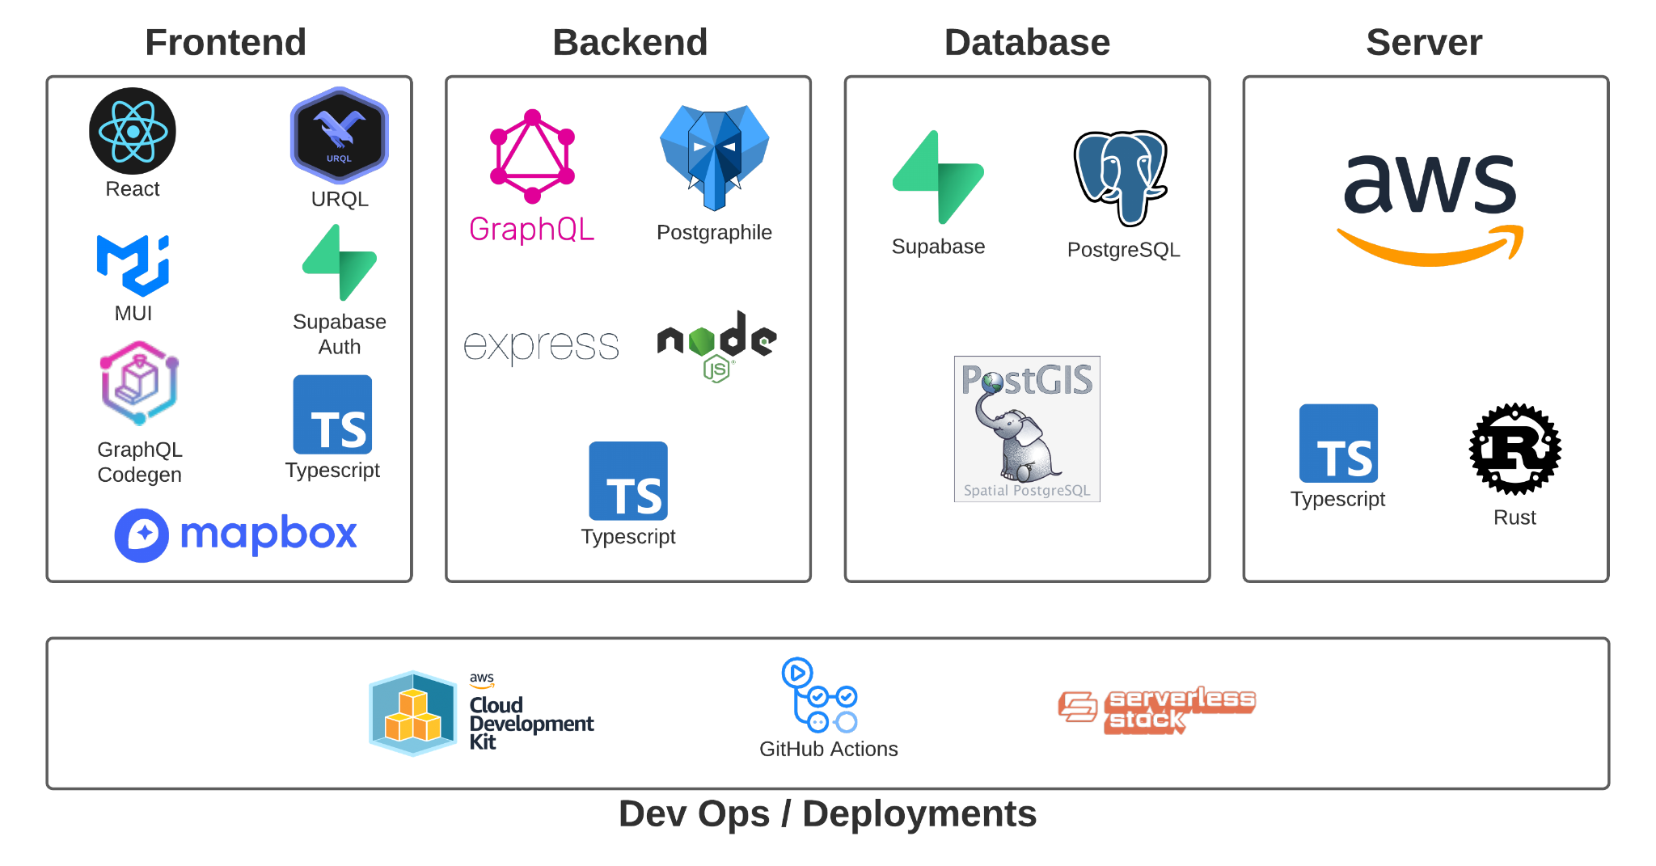
Stack Design

Slide 33
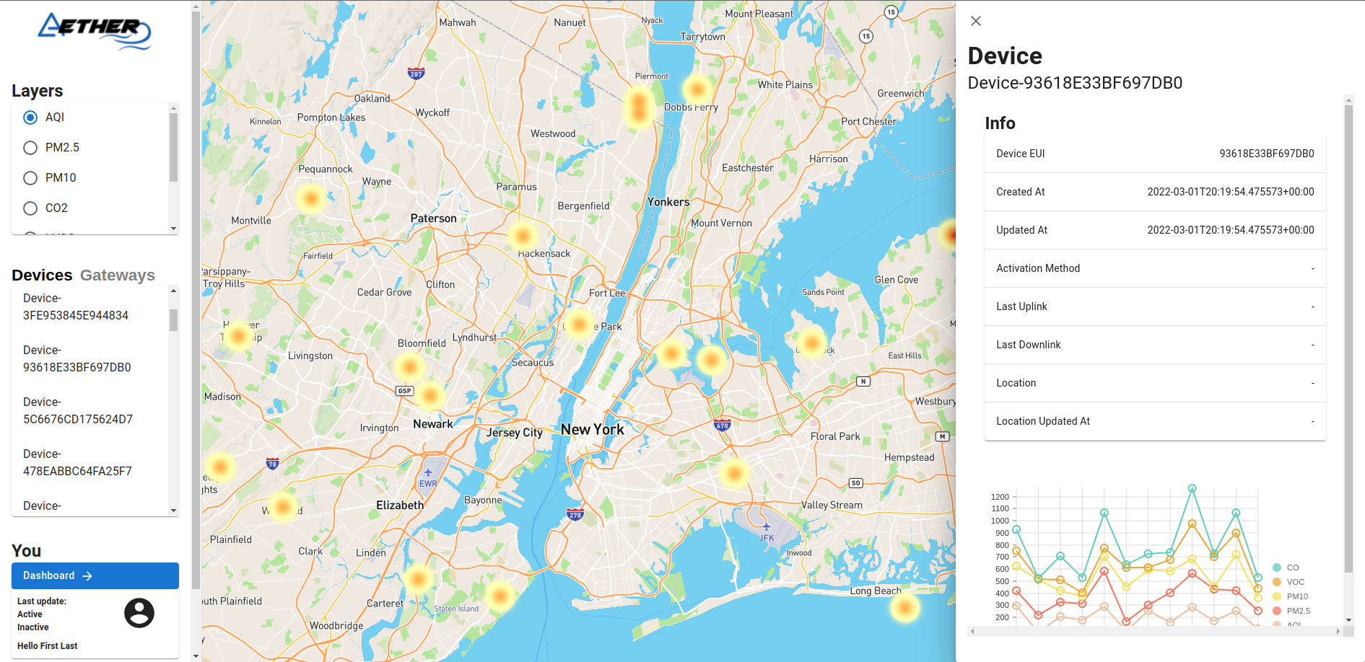
Current State of the Web Application
Test data

Slide 34
Why GraphQL
Typing
Client can request the exact data it wants
No over/under-fetching
Tons of different types of IoT being ingested, along with metadata
Would be annoying to manage that with multiple endpoints
Provides a single gateway to other services
Postgraphile
Notes:
Less friction than managing multiple endpoints that may break when the fields change/update
Typing catches errors

Slide 35
Why RDS (PostgreSQL) Over NoSQL
IoT data is inherently relational
Data comes from a sensor, which has a state and config, which belongs to a device, which is located somewhere, which belongs to a user, etc
RDS allows for joins to get the data you need easier
PostgreSQL supports JSON, JWTs, Python scripting, GIS data
Postgraphile framework simplifies backend development
Generates GraphQL API by inferencing the PostgreSQL schema
We can focus on the main application logic - huge time saver
Still have control over the GraphQL schema through plugins and PostgreSQL table views and functions
I wanted to learn SQL
Not really a good design consideration, but this project is about learning

Slide 36
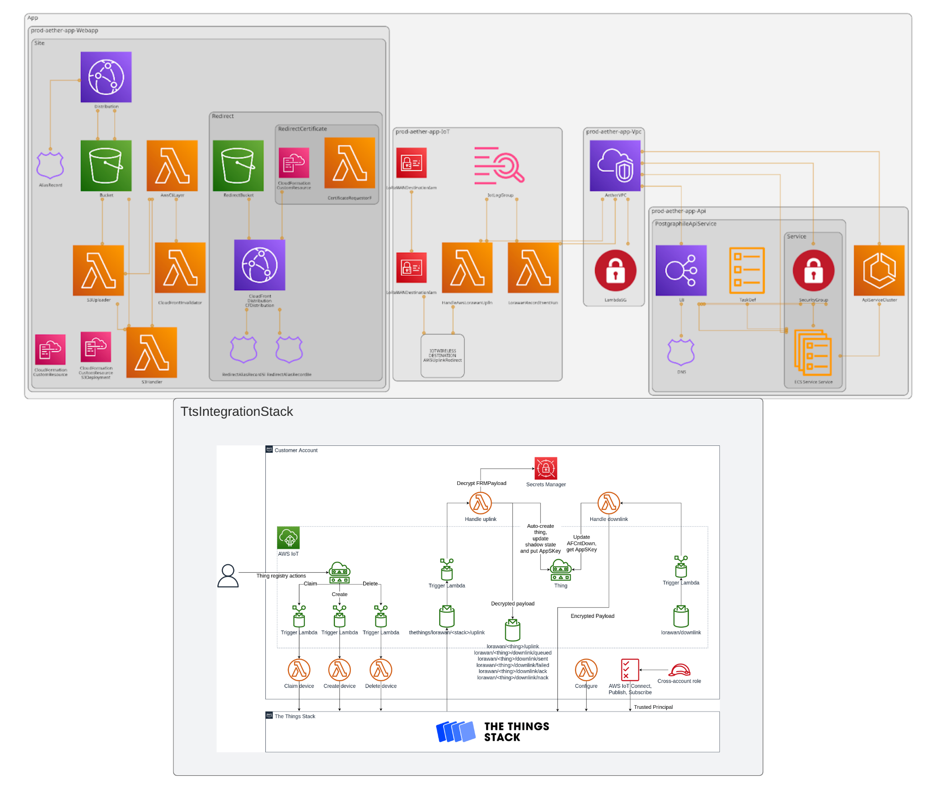
Backend Design
Generated with github.com/pistazie/cdk-dia

Slide 37
Backend Gotchas
Use all AWS services or pay for a NAT
Can run one on an EC2 instance with the free-tier, but it’s more complicated
Lambdas require a NAT to access the internet
Makes sense in hindsight, but is unfortunate
If you don’t create alarms, be ready for surprise AWS bills
AWS is more of a cloud provider that lets you create your own cloud
If you just want to run code, you quickly run into complexity as the project evolves
Everything has a ton of documentation (which is great), but there’s a really high learning curve
Going purely serverless has its own challenges and added complexity
CodeBuild is expensive and slower than GitHub Actions

Slide 38
Administrative Content

Slide 39
Other Challenges
Managing complexity amongst a team is hard
Feature creep
Notes:
Randy

Slide 40
Budget
Item | Cost($)
PCB | 26.45
PCB Components | 55.02
Sensors | 77.13
Lora Module | 8.38
Device Casing | 0
Solar Panel | 35.00
Battery | 16.95
Total | 218.93

Slide 41
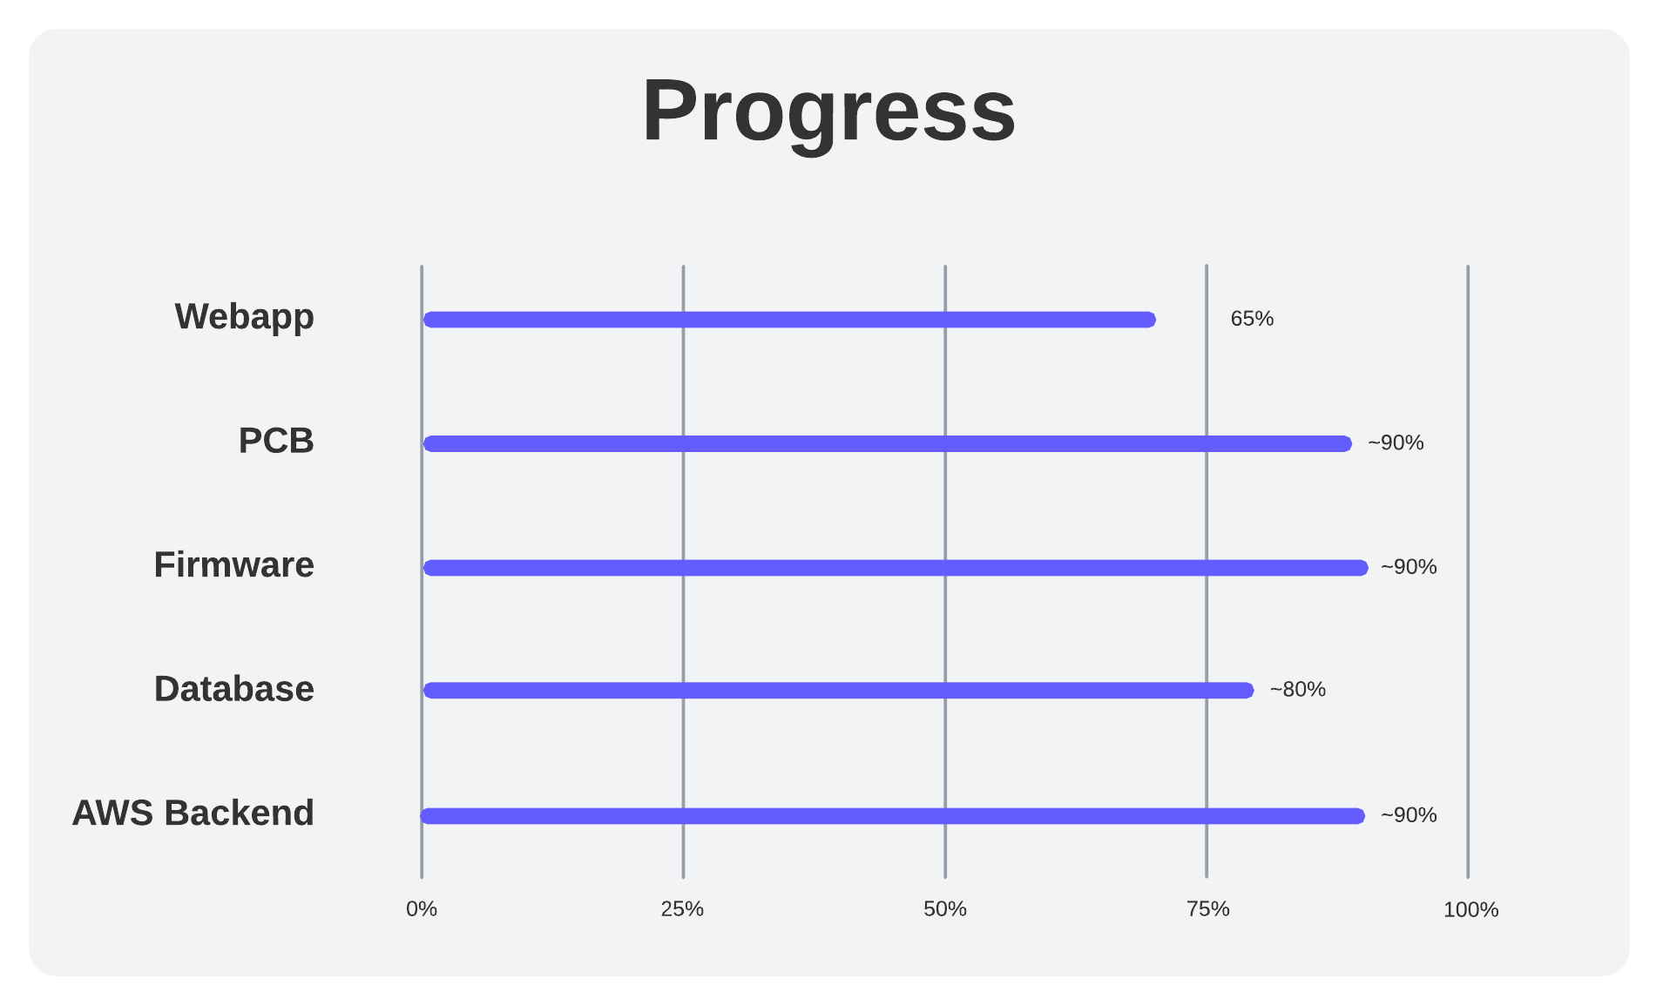
Project Progress

Slide 42
Work Distribution
 | Schematic | PCB | Enclosure | TUI | Firmware | Backend | Web App
Parke | ++ | + | ++
Randy | ++ | ++ | ++ | +
Paul | + |  |  |  | + | ++ | ++
Ian | + |  |  | ++ | ++

Slide 43
Next Steps
Perform end-to-end integration testing of the subsystems
Start work on serial communication protocol and terminal user interface (TUI)
Test and prototype the 3D printed device enclosure
Decide on next PCB revision
User dashboard, polish UI
Documentation
Notes:
Parke

Slide 44
Questions?

